Slide 1

Course 2 Capstone
The OSEMN Process

Slide 2
GOALS AND OBJECTIVES
To help us better understand the data we have to use to inform business decision and to solve our business problem of increasing sales of pet products through, we came out with some objectives for the project. They include the following:
To understand the top 5 niche pet products to add to our product line by the end of December
To identify the top 5 distinguishing demographics of our new customers to customize our pet product offerings to their needs for the launch in December.
To determine the growth/decline of sales in the next 6 months and what factors contribute to it.

Slide 3
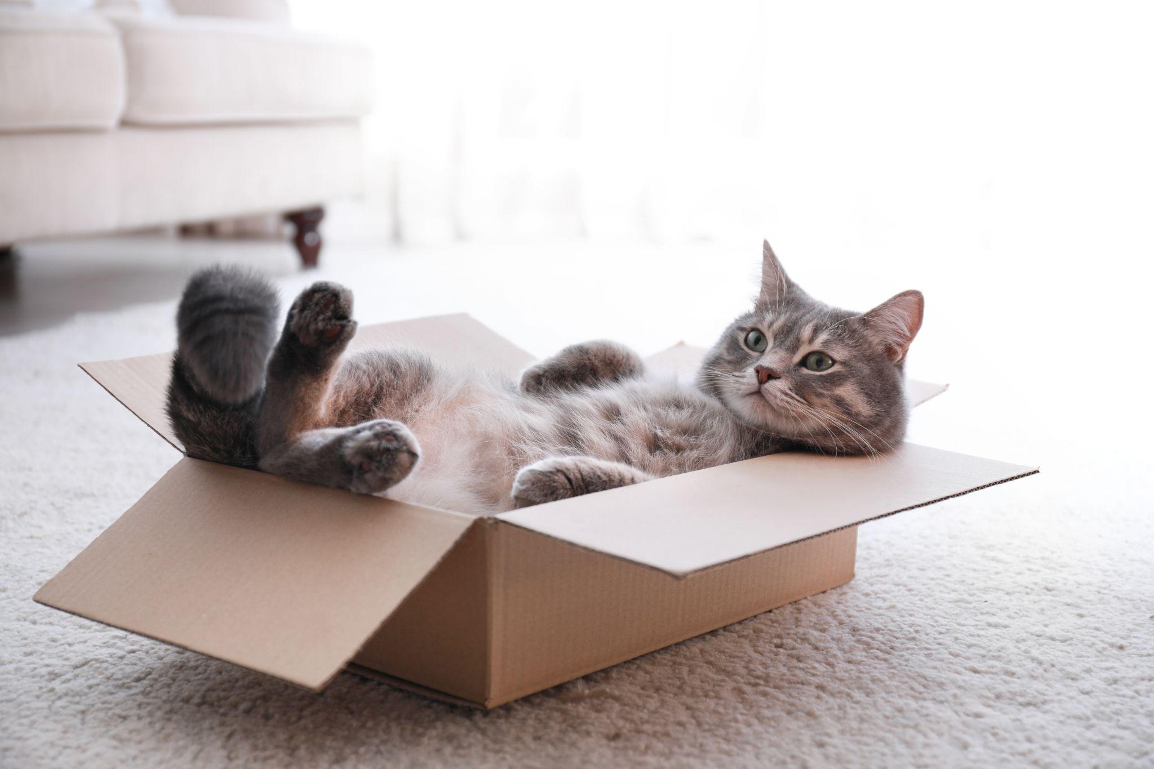
DATA SOURCES
Our data sources are varied but we sort to first understand the internal data gotten from our customers’ interaction with our website to make purchases. These data include the following:
Sales data
Orders data
Customer data
Inventory data

Slide 4
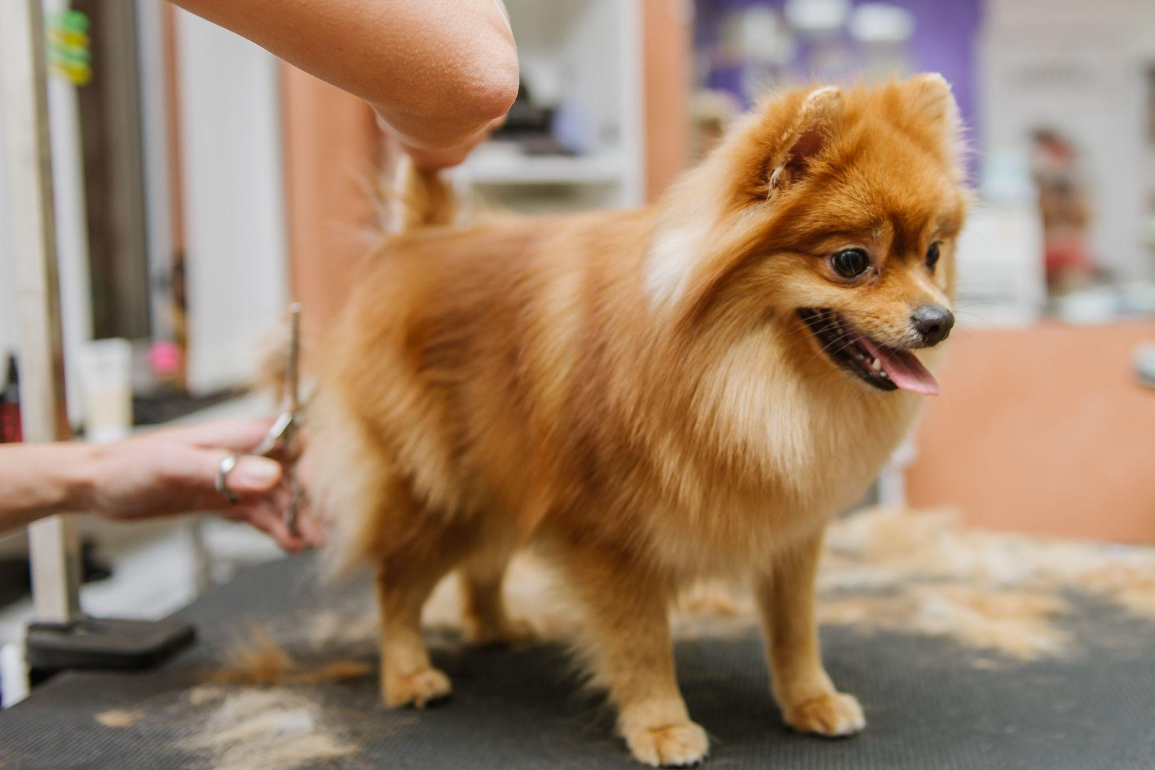
DATA COLLECTION PROCESS
To serve our data analysis needs to help us answer our business problem, we performed the following steps to gather information:
Extract data from the database of order made on the website and store in a CSV file for further analysis.
Third party data on ad performance (facebook, google)
Customer review on website, google, other social media platforms.

Slide 5
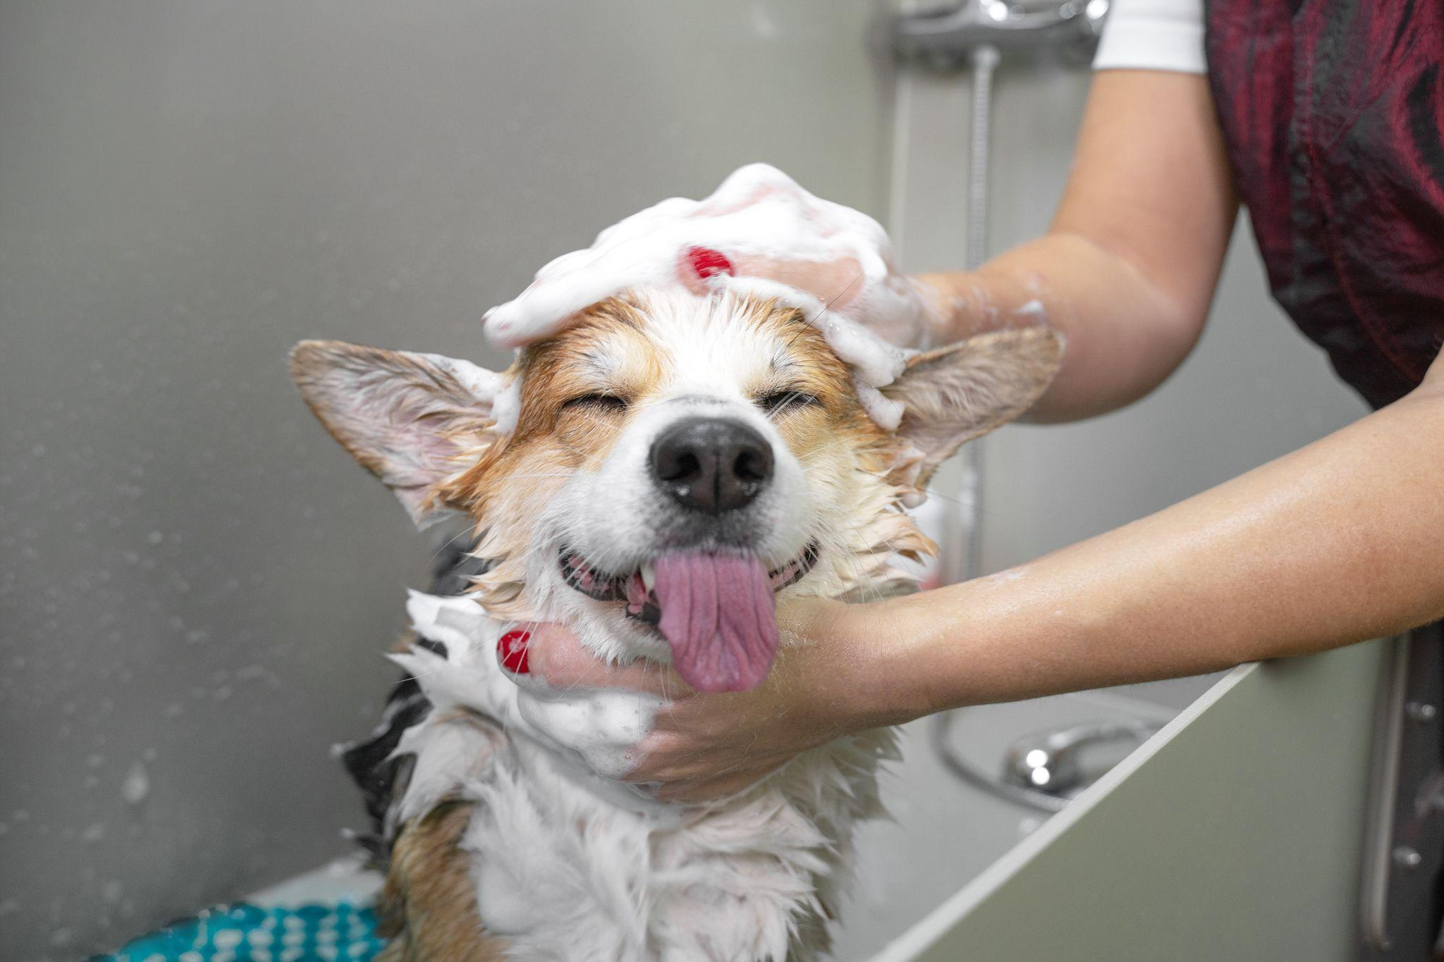
CHALLENGES IN THE DATA COLLECTION PROCESS
We faced some challenges in the data collection process as we would have like to have access to some information to improve the effectiveness of our business model. Some of the challenges included:
Limited time to carry out a full scale data collection to serve our needs
Missing values
Duplicate records
Obviously wrong values

Slide 6
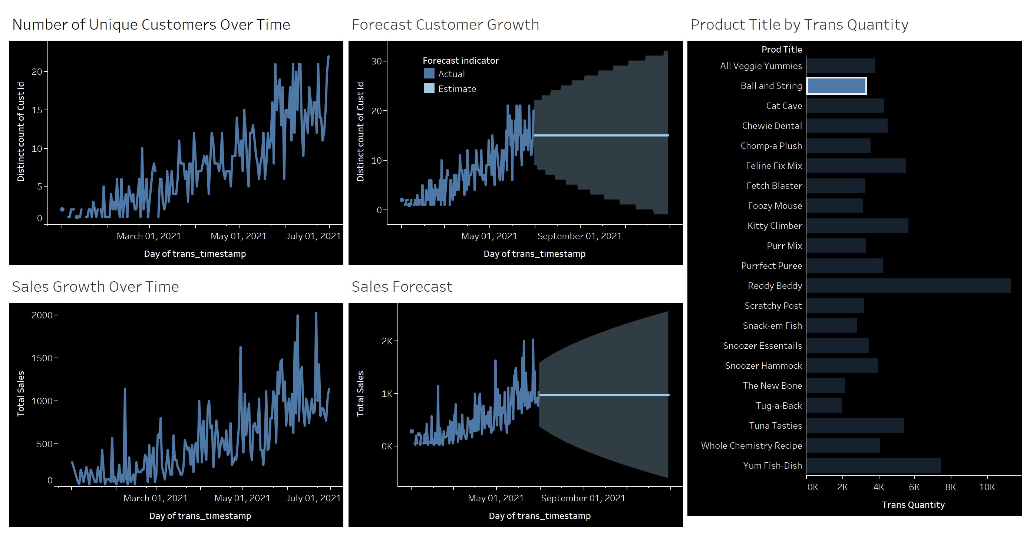
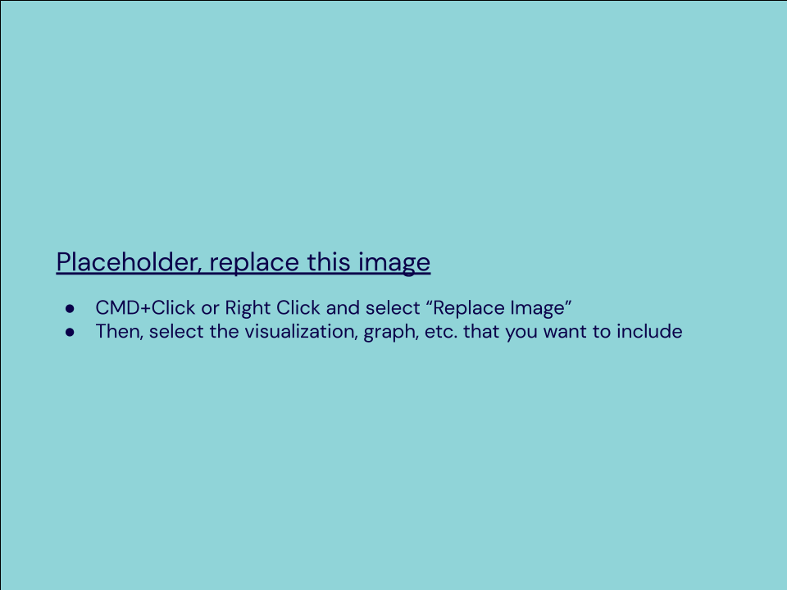
VISUALIZATION BASED ON ANALYSIS
The visualization below shows the results of our findings to the business growth problem
Notes:
https://public.tableau.com/views/inu_neko_orderline_clean/Dashboard1?:language=en-US&publish=yes&:display_count=n&:origin=viz_share_link

Slide 7

INTERPRETATION OF FINDINGS PART 1
Based on our findings we uncovered that:
There is a steady growth in customer base spread across different geographical regions in the US.
The customer growth forecast show that there would be 158% increase in customer base partly accounted for by the seasonal effect due to the Christmas festive period.
Customer base is estimated to hit a high point of 978 by January 2022.
The demographic of the top 3 state New York, New Jersey and Pennsylvania are east coast regions.

Slide 8
INTERPRETATION OF FINDINGS PART 2
We also noticed some interesting trends in our analysis. Some of which include:
There is a high fluctuation in the sales growth with sharp high and lows throughout the period under consideration (January 2021 - June 2021).
Sales growth showed highs of $21,659 in June, 2021 which could be attributed to peak season sales as it dropped shortly after.
Sales forecast shows a staggering 142.3% increase in sales for the period of June 30, 2021 - December 29, 2021.
Seasonal effect on the growth on sales (0.5%) is minimal thereby highlighting a trend which is likely to continue with the right products and marketing efforts.
Reddy Beddy is the best selling product with a cumulative quantity sold of 6582 units. Meanwhile, the Tug-a-Back is was the worst selling product with 1152 units sold.

Slide 9
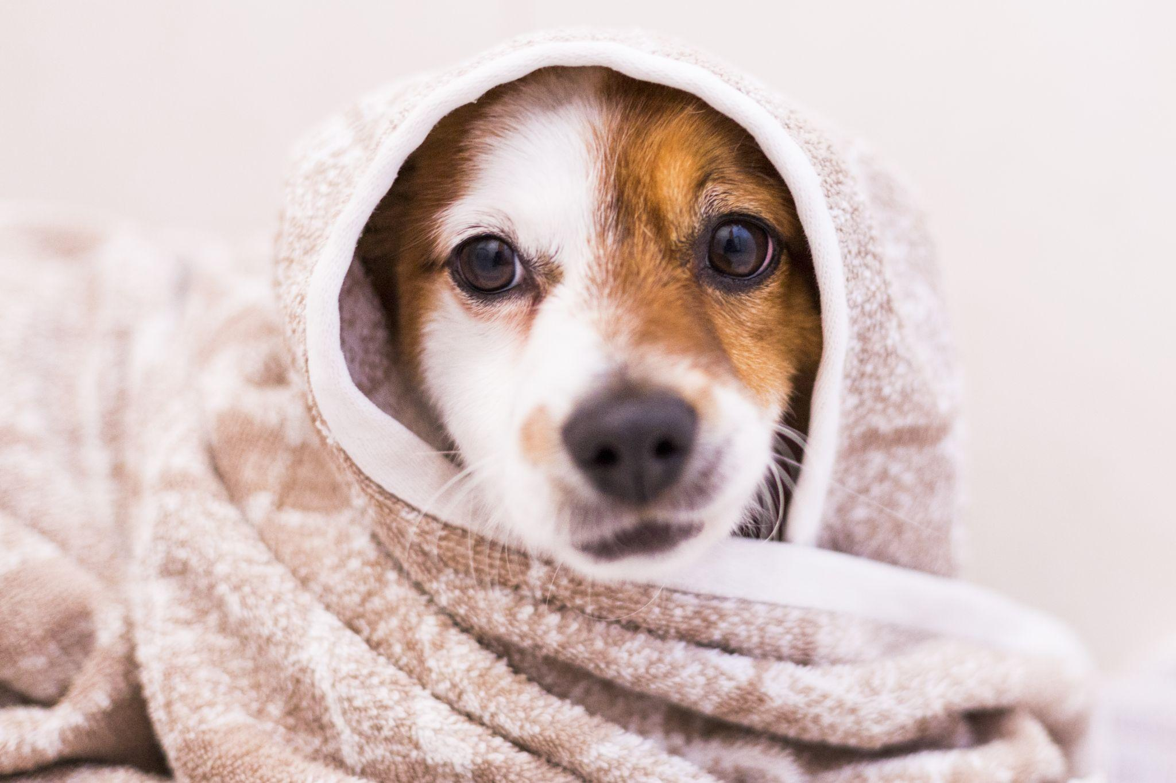
Recommendations Based on Model Results 1 of 2
There are a couple of recommendations that we can provide to help achieve the business goals and key objectives:
Based on our model which shows a high sales forecast, it would be great to launch a new product line (dog beverage) in December to take advantage of the peak season which will lead to greater sales already brought about by the trend.
A marketing campaign that seeks to understand more about the demographics of clients’ for this new product

Slide 10
Recommendations Based on Model Results 2 of 2
Further recommendations based on our analysis and model include:
A subscription model can be adopted for the sales of pet products in top 3 states which after experimentation can scaled out to other regions. The subscription-based model will require customers to be a monthly subscription fee to which enable them choose a blended package of pet food supplies.
Customers who will also be able to save up on delivery fees by paying a monthly subscription fee with discounts on select pet products. This will encourage the sale of underperforming products.

Slide 11
CONCLUSION
Inu + Neko since it’s launch have won the hearts of our client with our affordable high quality products with exceptional service that demonstrates that we care for our customers pets. Some few points to consider about the current state of the business:
Customer base sits at a total 26,034
Gross cumulative sales for the first half of the year $1,609,489
Top 5 states grouped by sales include New York, Pennsylvania, New Jersey, California, and Connecticut
Top 5 best products include: Reddy Beddy, Cat Cave, Kitty Climber, Snoozer Hammock and Snoozer Essentials

Slide 12
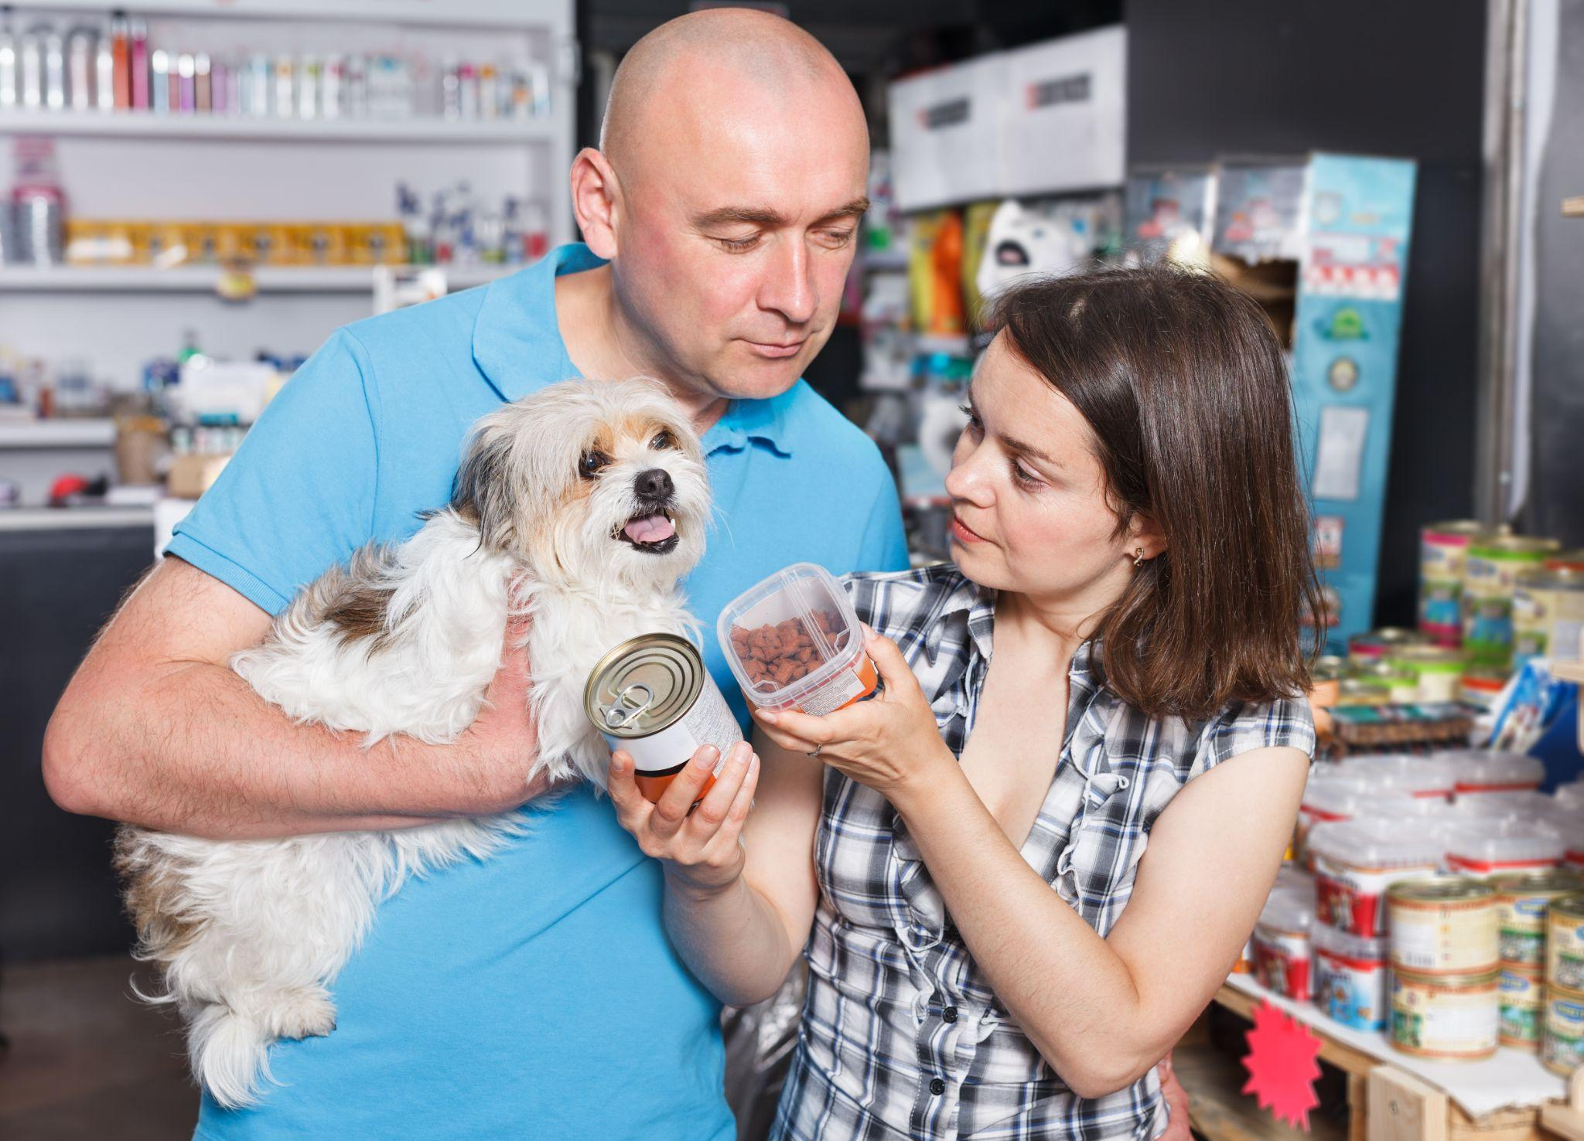
FUTURE PROJECTIONS
There a few future plans we are looking at embarking on to help us increase sales and release new product offerings to meet our customer needs
Recommendation model that recommends products to our customers based on their past purchases and their satisfaction ratings.
Series of new product lines that incorporate other pet food types including parrots, bunnies, etc.

Slide 13
OPPORTUNITIES FOR FURTHER RESEARCH
There are several opportunities to improve future research and to overcome obstacles that we faced in this research. Some of this opportunities include:
Partnership with research institutions to gather secondary data on the dog needs of residence of different demographics to overcome the barrier in getting first-hand data.
Work closely with third party website analytics companies such as google analytics and facebook on seeking feedback at each level of the sales funnel to better understand the pain points and obstacles of moving from one stage to another.
Perform A/B test on two marketing campaigns to understand which clicks best with the customers and generates more leads which lead to sales.

Slide 14
RECOMMENDATIONS
Based on our analysis we have a few general recommendations to Inu + Neko to achieve their goals:
Build a full-service marketing science department whose responsibilities will include understanding the effectiveness of our campaigns and understanding the kinds of products that customers love based on sales and other marketing KPIs
Roll out a trial subscription based pricing model in high sales regions
Add to product line more vegetarian pet products to meet the needs of vegetarian dog owners who want to train their dogs in a similar manner.
Incorporate data collection at every stage of the sales funnel to avoid the effort and time spent in data collection and analyses.

